Slide 1



THE INTERACTION

Slide 2
Interaction Models
The term of interaction
Execution evaluation cycle
The interaction framework
Ergonomics
physical environment of interaction
Health issues
The Use of Color
Interaction Styles
Command line interface
Menus
Natural language
Query dialog
WIMP Interface

Slide 3
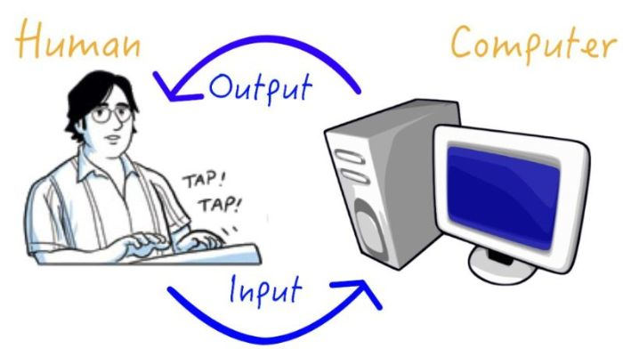
The term of interaction
In Human-Computer Interaction (HCI), the term "interaction" refers to the communication and exchange of information between a user and a computer system. It encompasses the actions users take to input information into a system, how the system processes that input, and how it presents feedback or output to the users

Slide 4
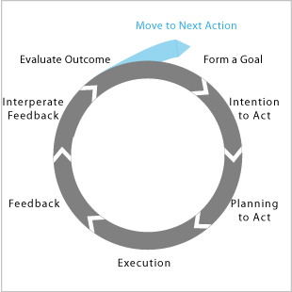
Execution evaluation cycle
"The "execution-evaluation cycle" in Human-Computer Interaction (HCI) refers to the iterative process that users go through when interacting with a computer system. This cycle involves the user performing actions, the system responding to those actions, and the user evaluating the system's response.
Norman’s model of interaction

Slide 5
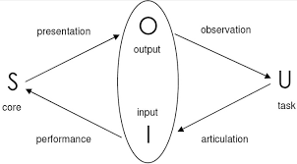
The interaction framework
key components of interaction framework
The interaction framework refers to the conceptual model or structure that helps designers and researchers understand and analyze the various components involved in human-computer interactions. It provides a systematic way of thinking about how users interact with technology and how to design interfaces that support effective and efficient interactions.

Slide 6
Ergonomics
Physical Environment of Interaction: Think about where people use computers. Make sure the space is comfortable, well-lit, not too noisy, and has ergonomic furniture (chairs, desks) to prevent physical discomfort.
Health Issues: Using computers for a long time can lead to health problems. Designers should consider:
Eye Health
Physical Strain
Avoiding Sitting Too Much
The Use of Color Choose colors wisely in interface design:
Contrast
Color Coding
Avoid Eye Fatigue
Emotional Impact:

Slide 7
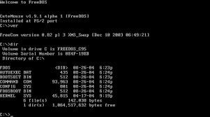
Command line interface
Command line interface:
Here users interact with a computer or software by typing commands in a text format. This involves entering specific instructions or requests, and the system responds with text-based outputs.

Slide 8
WIMP Interface
WIMP stands for "Windows, Icons, Menus, Pointer," and it's a way computers look and work on screens. Here's what each part does:
Windows: Think of your screen like a bunch of moveable and resizable boxes. Each box is a window that holds a specific app or information.
Icons: Icons are small pictures representing files, folders, or apps. You can open files or start apps by clicking or tapping on these little pictures.
Menus: Menus are like lists of choices. When you click on a certain spot, a list of options pops up, usually at the top of a window or the screen. It helps you find and use different functions and settings.
Pointer: The pointer is the arrow or symbol on your screen. You control it with a mouse or touchpad. To interact with the computer, you move the pointer and click on things

Slide 9
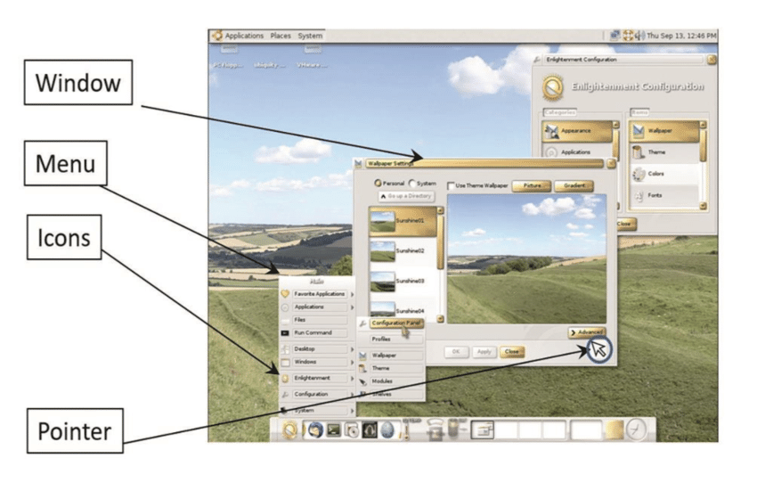

Slide 10
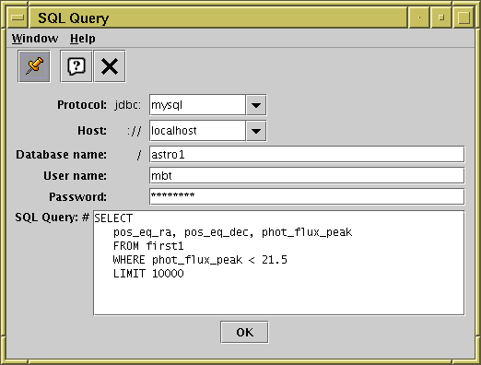
Query dialog
Query dialog is a user interface element designed to obtain specific information from the user through prompts and input fields. It serves as a means for users to interact with software applications by providing the necessary data for various tasks or processes.

Slide 11
Natural language
Natural language is used to create interfaces that allow users to communicate with computers in a way that feels familiar and intuitive. This involves designing interfaces that understand and respond to everyday language, whether spoken or written. Natural language is applied in voice recognition, chatbots, and text-based interfaces, enhancing user experiences by making interactions more user-friendly and accessible. Consideration of cultural variations, multimodal interactions, and user-centric design principles ensures that interfaces align with users' communication preferences.

Slide 12
THANK YOU

